Slide 1
19ECE301 Control Theory
5th Semester B.Tech ECE

Slide 2
Lecture overview
Control system Definition
Need for study Motivation
Advantages of control systems
System Configurations
Analysis and design objectives
Design Process

Slide 3
Control System Definition
Control is to make some one or something behave in a desired manner
Control systems consists of sub-systems assembled for the purpose of obtaining desired output with desired performance when given a specified input.
Example: Elevator (lift), Air Conditioned room

Slide 4
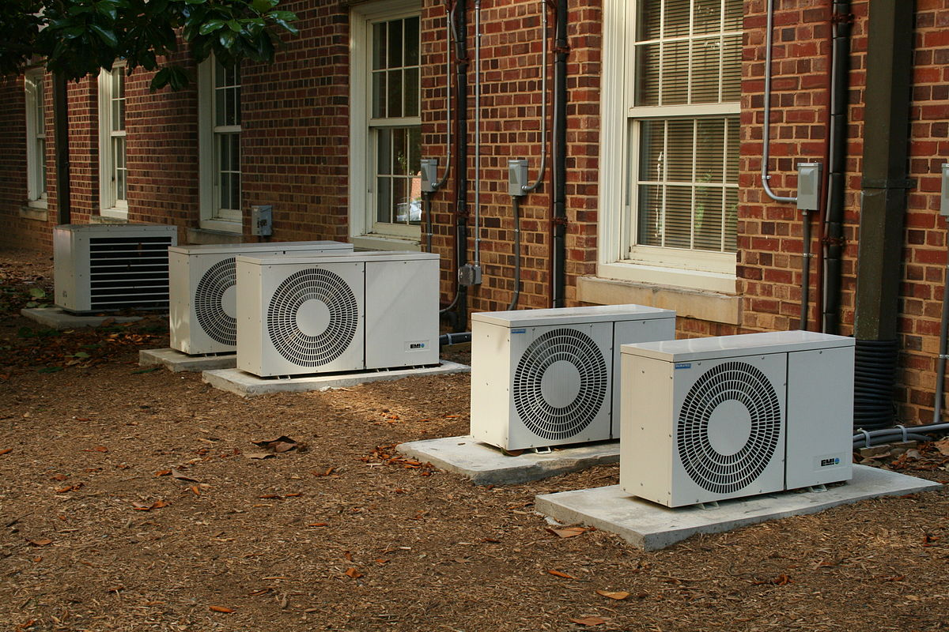
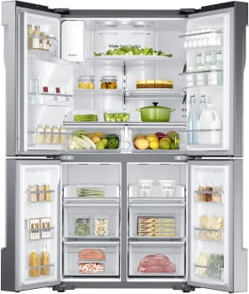
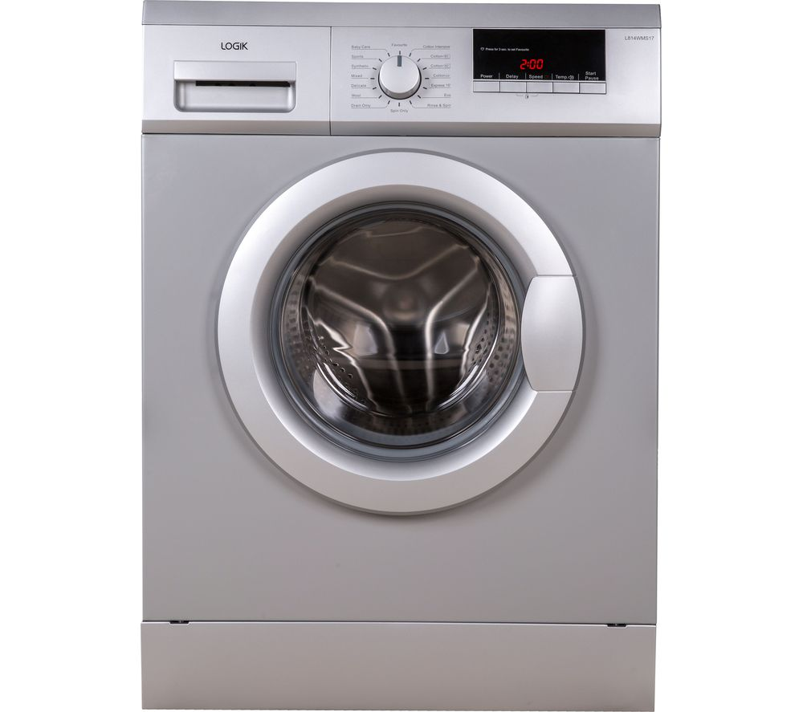
Need for study
Control systems part of modern society
Air Conditoners, Refrigerators, washing machines,

Slide 5


Need for study of control systems
Control systems part of modern society
Automatically machined metallic parts, hard disk reading head

Slide 6
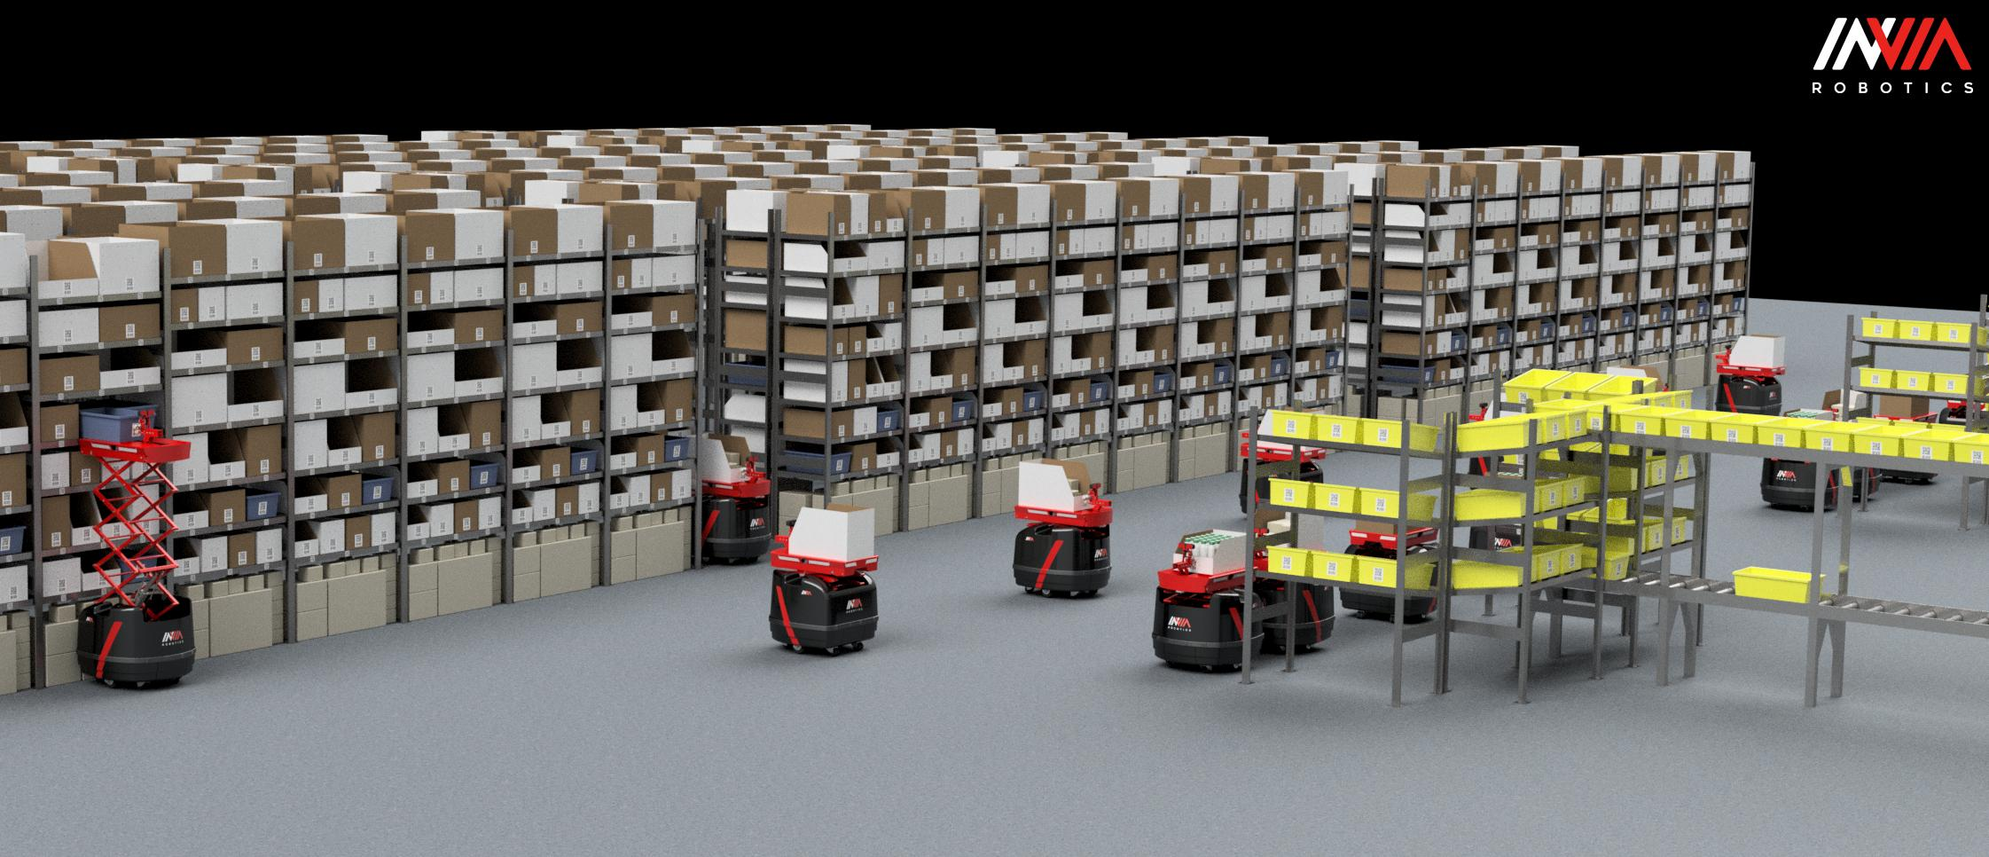
Need for study of control systems
Control systems part of modern society
Robots delivering material to work station in a factory floor

Slide 7
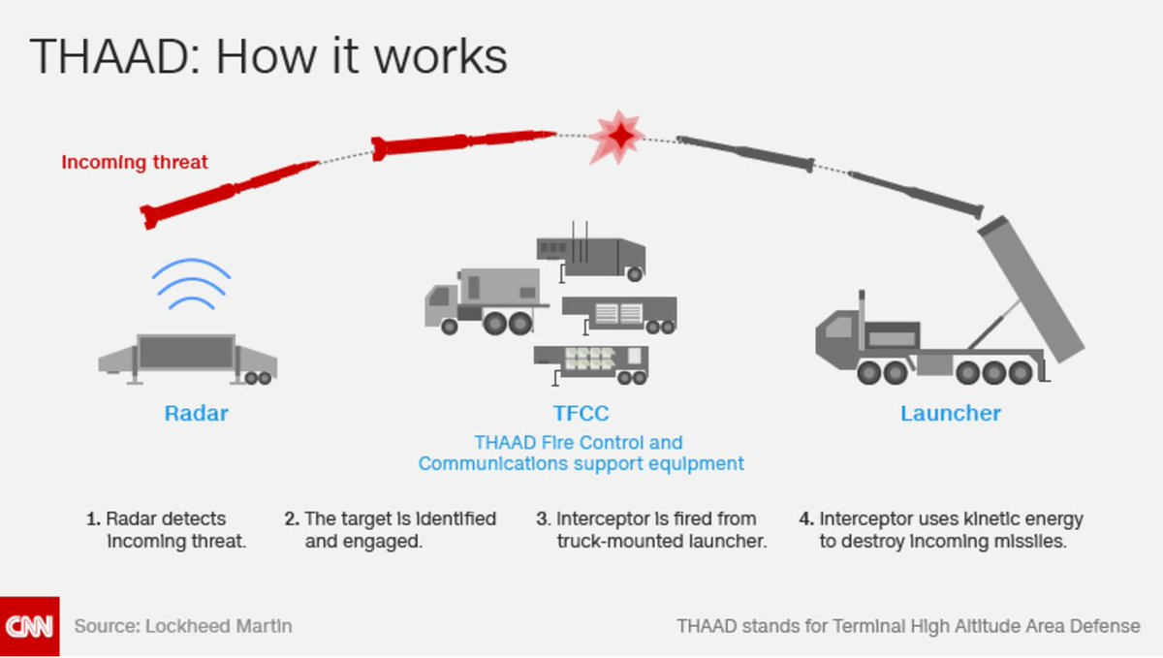
Definition and Need for study
Control systems part of modern society
Enemy missiles tracked and shot down.

Slide 8

Definition and Need for study
Control systems part of modern society
Unmanned airplanes (drones) doing surveillance ……

Slide 9
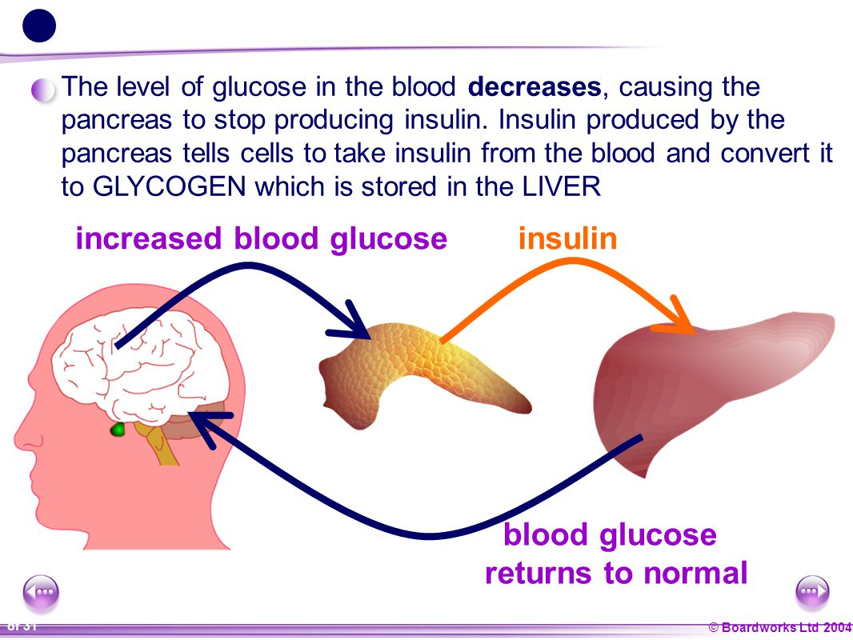
Definition and Need for study
They are part of nature
Blood sugar control by pancreas
Temperature control in the body

Slide 10
Definition and Need for study
Many non-physical situations can be cast as Control problems
Many economic issues
Student performance with input as study time and output as grade
…….
Summary
Integral Part of modern society, part of nature, many non physical situations can be seen as control problems
So not only an Electronics Engineering but every engineer should know

Slide 11
Advantages of control systems
Power amplification
Moving a lift, positioning an big antenna precisely
Remote control
Operate on parts located in a radioactive environment or in far off places
Convenience of input
Input to a temperature control system can be fed as a position of knob
Compensation for disturbances
wind forces acting on an antenna, room temperature control disturbances are opening and closing of doors windows

Slide 12
System configurations
Open-loop (OL) system
Examples
Washing machine (input: time, output: clean cloth)
Toaster (input: time, output: colour)
Irrigation sprinkler (input: time, output: soil moisture)
Motor speed control (input: voltage, output: speed)
Has poor sensitivity to disturbances, i.e., it cannot compensate for disturbances that add at the input and at the output of the plant

Slide 13
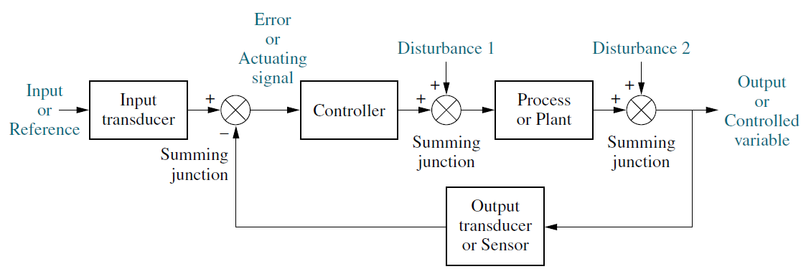
System configurations
Closed-loop (CL) system
Example: Washing machine (hypothetical),
Cruise control (input: throttle, measurement: speed, output: speed)
Corrects for disturbances by gathering measurements, feeding measurements back through a feedback (FB) path, and comparing measurements to inputs

Slide 14
System configurations
OL system
Advantages
Simple
Inexpensive
Disadvantages
Lower accuracy
Higher sensitivity to noise,
disturbances, and changes in
the environment
CL system
Advantages
Higher accuracy
Less sensitivity to noise,
disturbances, and changes in
the environment
Disadvantages
Complex
Expensive
Stability
In modern control systems the computer plays the role of the controller and brings many advantages like time sharing, multiple roles and ease of change

Slide 15
Definition (revisited)
Control systems consists of sub-systems assembled for the purpose of obtaining desired output with desired performance when given a specified input.
Example: Elevator
(response of an elevator)

Slide 16
Analysis and Design Objectives
word “desired performance” is important
Analysis is the process by which a system’s performance is determined
Design is the process by which a system’s performance is created or changed.
Three major objectives
Transient response (example of elevator and hard disk)
Steady state response (example of elevator, hard disk and antenna)
Stability

Slide 17
Analysis and Design Objectives
Transient response and steady state response performance definitions not useful if the system is not stable.
To understand stability we have to understand about the Natural (transient)* and forced (steady state)* responses.
For a linear system
Total response= Natural + forced.
Natural response :Due to the system and the way the system acquires or dissipates energy
Forced response : Due to input

Slide 18
Analysis and Design Objectives
For unstable systems natural response is so much greater than the forced response
For stable systems the natural response should decay or oscillate
Other Considerations
Robustness--Sensitivity to parameter changes
Hardware selection, e.g., power requirements and sensor accuracy
Economic

Slide 19
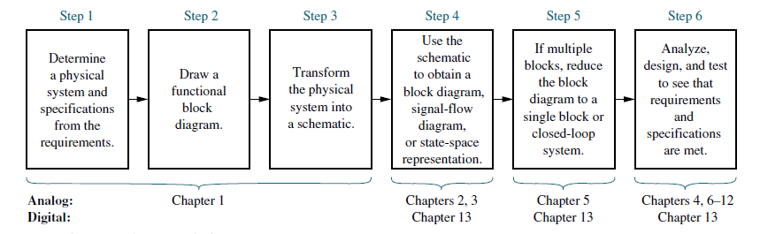
Design Process
The design flow

Slide 20
Case study
Antenna Azimuth Position Control System

Slide 21
Design process
1. Transform requirements into a physical system
System concept
Qualitative description
Determine inputs and outputs
Description of the physical system

Slide 22
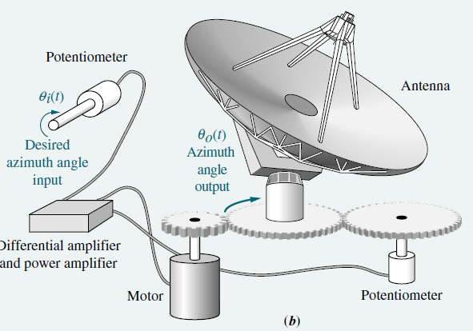
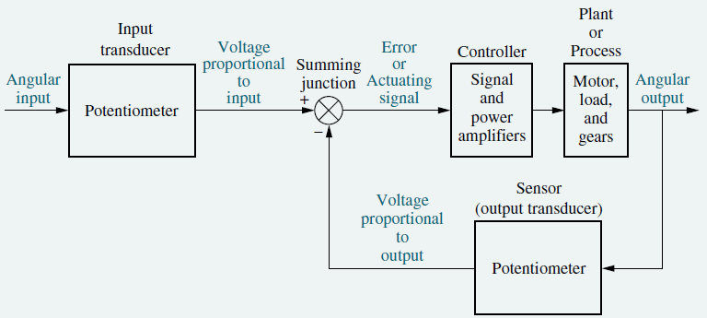
Design process
2. Draw a functional block diagram
Detailed layout
Describes the component parts of the system (function and hardware) and shows their interconnections

Slide 23
Problem
A room temperature control system operates by sensing the difference between the thermostat setting and the actual temperature and then opening a fuel valve an amount proportional to this difference.
Draw a functional closed-loop block diagram (similar to block diagram shown for antenna control system) identifying the input and output transducers, the controller, and the plant. Further, identify the input and output signals of all subsystems.

Slide 24
Voltage proportional to the error
Voltage proportional to the angular input
Angular input
Voltage
Input transducer
controller
Plant/process
External influences
noise
Summing junction
Temperature of the room
Signal and power amplifiers
Valves and heater along with the room
Potentiometer
Output transducer
Implemented using a difference amplifier
Voltage proportional to the temperature
Thermocouple with its conditioning circuitry

Slide 25
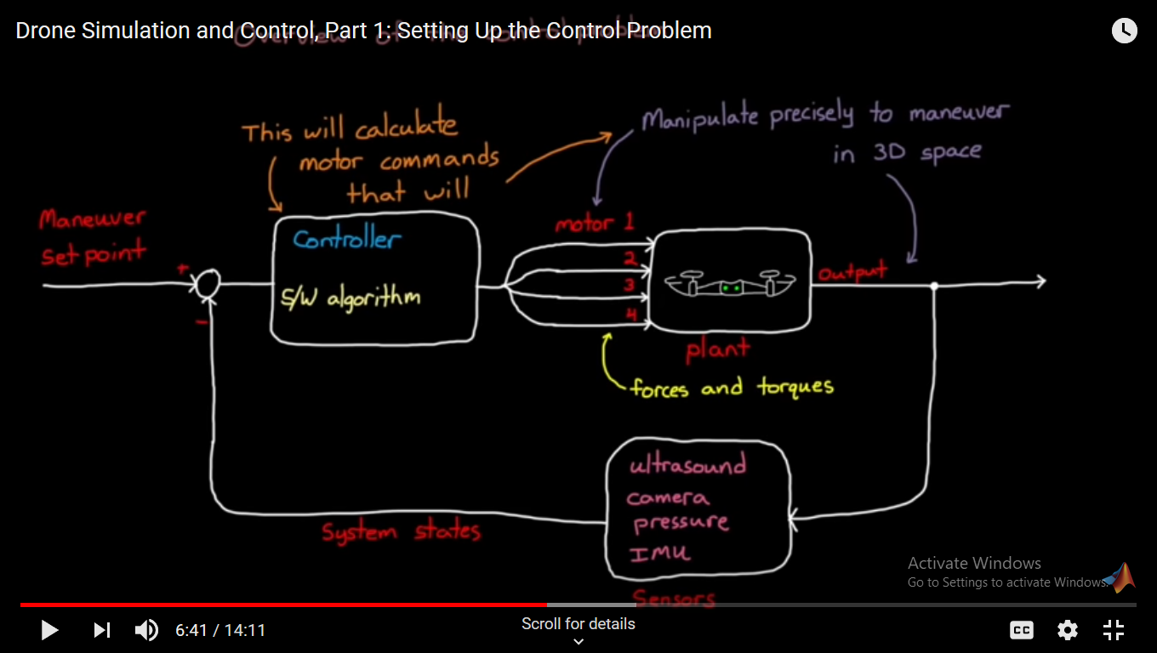

Slide 26
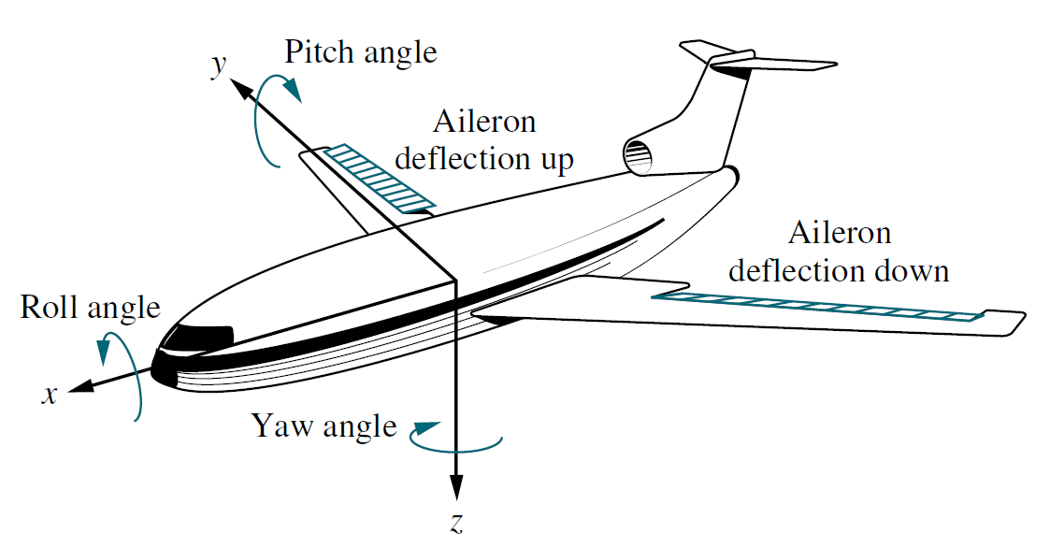
Problem
An aircraft’s attitude varies in roll, pitch, and yaw as defined in figure below. Draw a functional block diagram for a closed-loop system that stabilizes the roll.

Slide 27
Voltage proportional to the error
Voltage proportional to the angular input
Pilot input
Voltage
Input transducer
controller
Plant/process
External influences
noise
Summing junction
Roll angle
Microcontroller driver power amplifiers
Airplane with aileron control motor driven
Potentiometer
Output transducer
Implemented in software
Voltage proportional to the roll angle
gyro

Slide 28
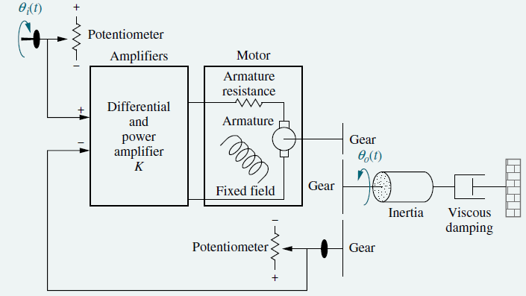
Design process
3. Create a schematic
Transform the physical system into a schematic diagram
Make approximations and neglect certain phenomena
Start simple, check assumptions later through analysis and simulation, if too simple, i.e., does not adequately account for observed behavior, add phenomena
Use knowledge of the physical system, physical laws, and practical experience

Slide 29
Design process
4. Develop a mathematical model (block diagram)
Use physical laws
Relationship between the inputs and outputs of the dynamic system
Linear, time-invariant (LTI) differential equations (DEs)
High order, nonlinear, time-varying, or partial DEs
Transfer functions (alternate representations of LTI DEs transformed using the Laplace transform)
State-space representation (alternate representation of nth-order DEs as n simultaneous first-order DEs)
Knowledge of parameter values

Slide 30
Design process
5. Reduce the block diagram
Interconnect subsystem models to form block diagrams of larger systems
Each block represents a mathematical description with dynamics, relations, inputs, outputs, and parameters

Slide 31
Design process
6. Analyze & design
Time response specifications and performance requirements
Test input waveform signals
Sensitivity analysis
Improve time response and performance
Adjusting system parameters
Design additional hardware
Minimize sensitivity over an expected range of environmental changes

